Slide 1
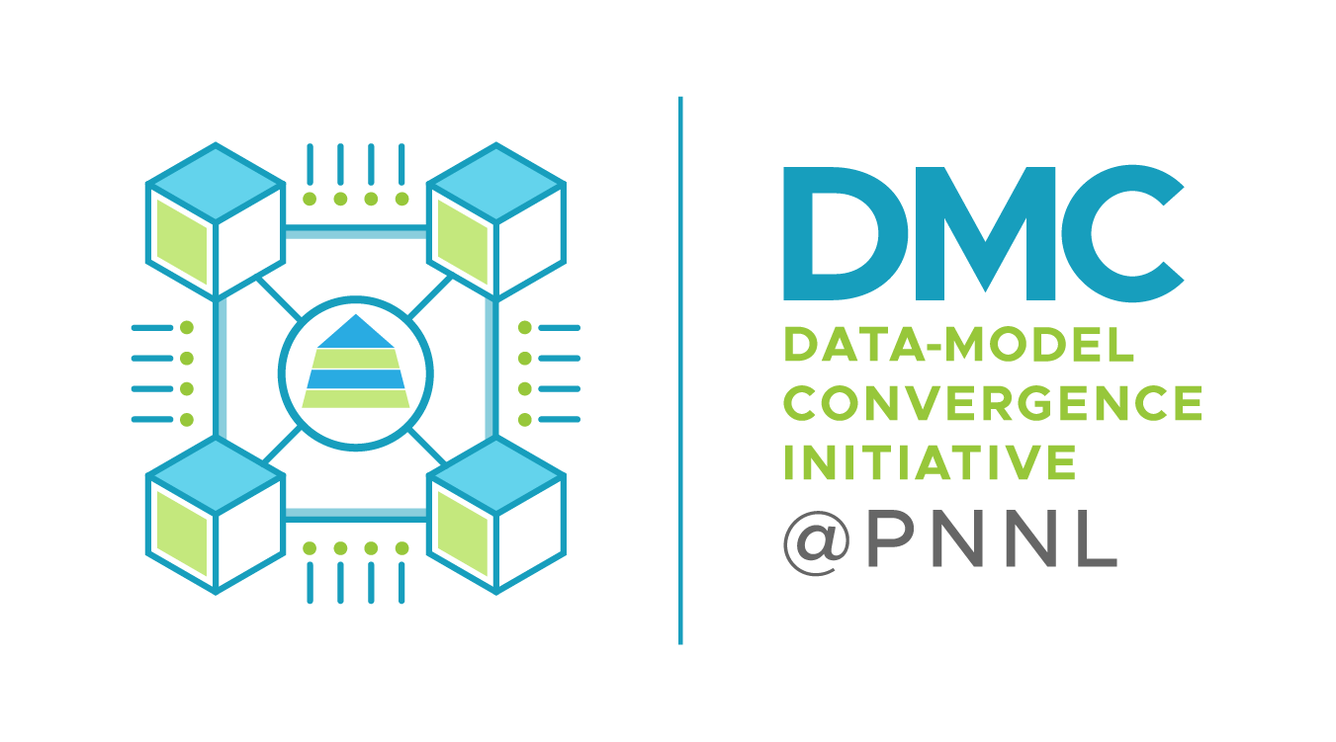
Differentiable Optimization as Lingua Franca for Scientific Machine Learning
2022 Sandia Machine Learning and Deep Learning (MLDL) Workshop
Ján Drgoňa Collaborators: Aaron Tuor, Ethan King, Shrirang Abhyankar, Sayak Mukherjee, Mahantesh Halappanavar, Draguna Vrabie

Slide 2

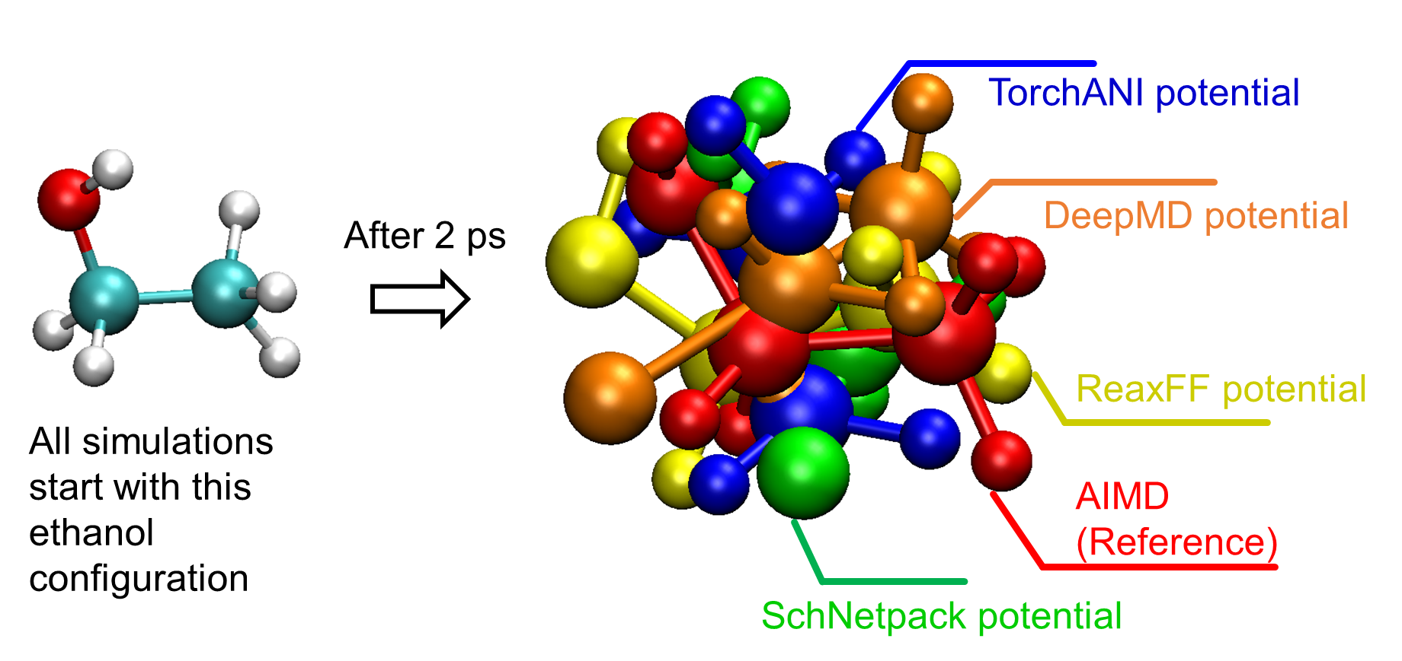
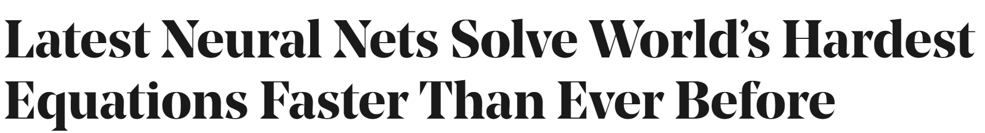
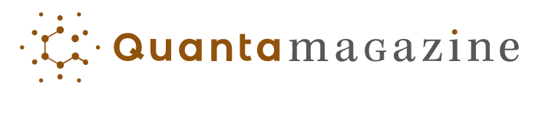
SciML Motivation and Aims
Simulations are crucial for many areas of decision-making and scientific discovery
Need: Improve computational efficiency and scalability for heterogenous scientific simulations
Objectives:
Domain-agnostic software and algorithmic framework
Scientific computing enhanced by data science
Algorithmic speedups enhanced with HPC
Applications: Optimization, modeling and control of dynamical systems (ODE, PDE, DAE, Hybrid systems)

Slide 3

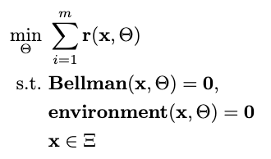

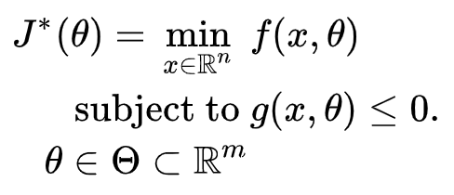

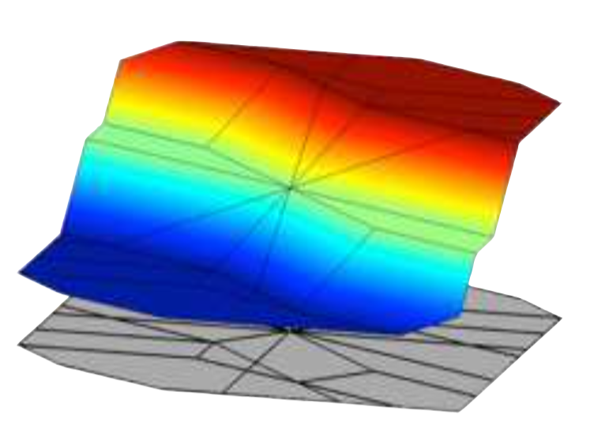
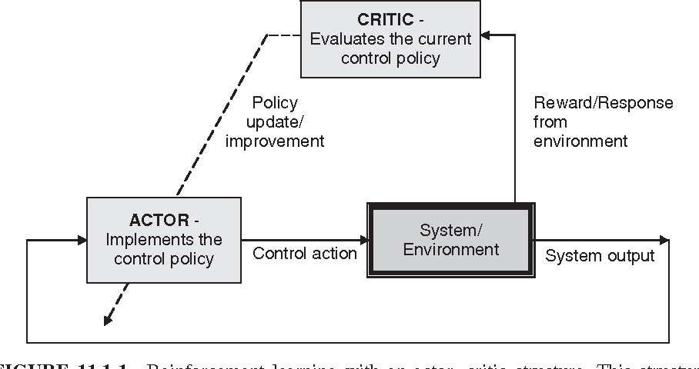

Landscape of Optimization Methods
Online optimization
Parametric programming
Imitation Learning
Reinforcement Learning
“online” solution for given parameter values
computationally demanding in real-time
“offline” optimization obtains a solution map
classical methods lead to exponential complexity!
“offline” optimization
obtains a model (map)
scalable but requires expert controller
“offline” optimization
obtains a policy map
classically can’t handle constraints

Slide 4
Landscape of Optimization Methods
Online optimization
Parametric programming
Imitation Learning
Reinforcement Learning
“online” solution for given parameter values
computationally demanding in real-time
“offline” optimization obtains a solution map
classical methods lead to exponential complexity!
“offline” optimization
obtains a model (map)
scalable but requires expert controller
“offline” optimization
obtains a policy map
classically can’t handle constraints
Differentiable parametric programming (DPP): a unifying approach for data-driven parametric programming optimization with solutions based on automatic differentiation (AD)

Slide 5
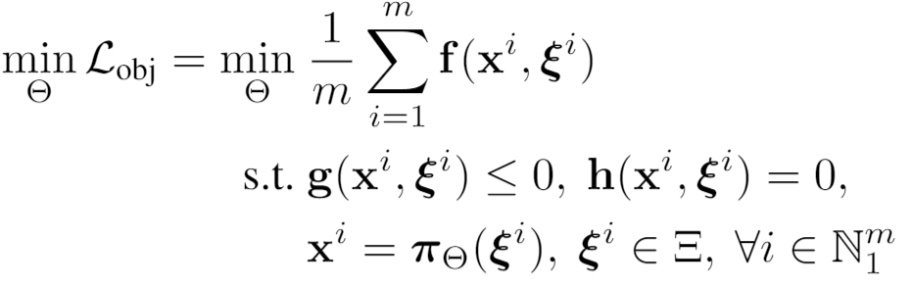
Differentiable Parametric Programming: Generalization of PINNs
Objective function
Problem formulation:
Constraints
Primal optimizers
Scenarios
Solution map
Parameters

Slide 6
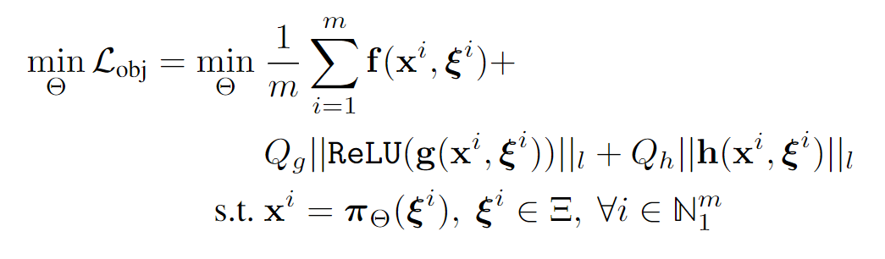
Differentiable Parametric Programming: Generalization of PINNs
Objective function
Problem formulation:
Constraints
Primal optimizers
Scenarios
Solution map
Parameters
Lagrangian form:
Constraints penalties
Gradient-based optimization based on AD

Slide 7
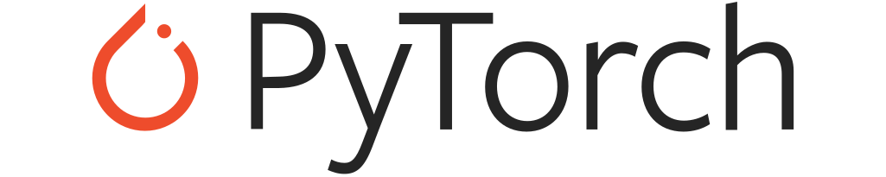
Differentiable Parametric Programming: NeuroMANCER toolbox
train_data, dev_data, test_data = get_dataloaders(samples)
p = Variable(‘p’) # sampled parameter
x = Variable(‘x’) # decision variable
y = Variable('y’) # decision variable
map = nm.MLP(input_keys=['p’], output_keys=[‘x’,‘y’], name='map’)
# parametric solution map
f = x ** 2 + y ** 2 obj = f.minimize(weight=Q, name='obj’) # objective function con_1 = Q_con*(-x - y + p <= 0) # constraint
con_2 = Q_con*(-x + y + p <= 0) # constraint
objectives = [obj]
constraints = [con_1, con_2] components = [map]
loss = PenaltyLoss(objectives, constraints, train_data) problem = Problem(components, loss) # differentiable optimization optimizer = torch.optim.AdamW(problem.parameters(), lr=args.lr) trainer = Trainer(problem,train_data,dev_data,test_data,optimizer)
best_model = trainer.train()
Neural Modules with Adaptive Nonlinear Constraints and Efficient Regularizations
https://github.com/pnnl/neuromancer

Slide 8
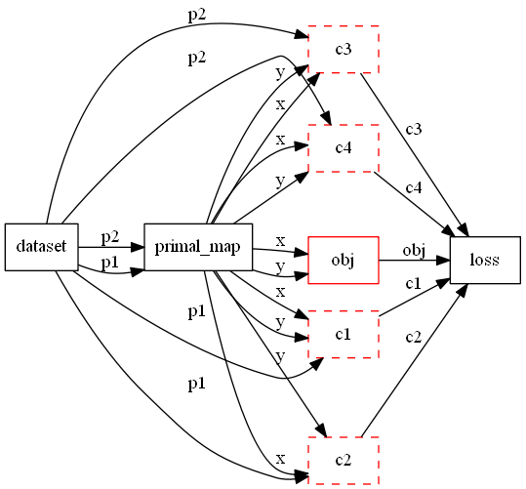
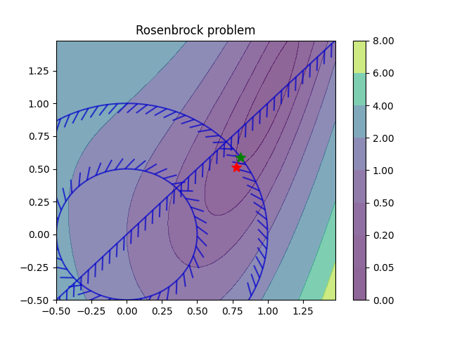
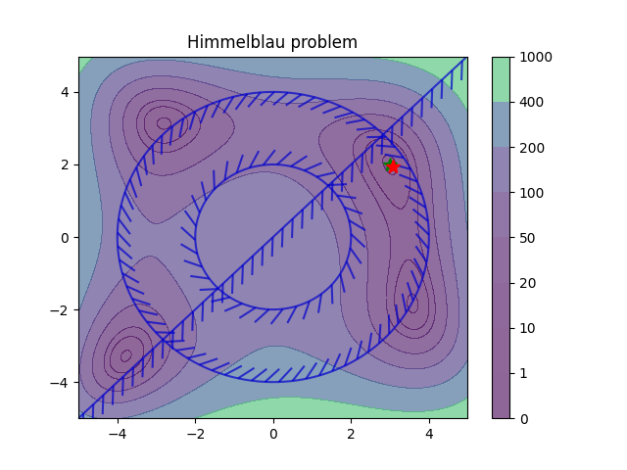
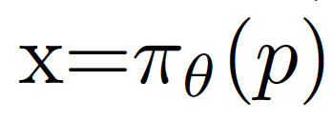
Differentiable Parametric Programming: Computational Graphs
Parametric nonlinear programs
Orders of magnitude faster online solution compared to online optimization solvers (IPOPT).

Slide 9
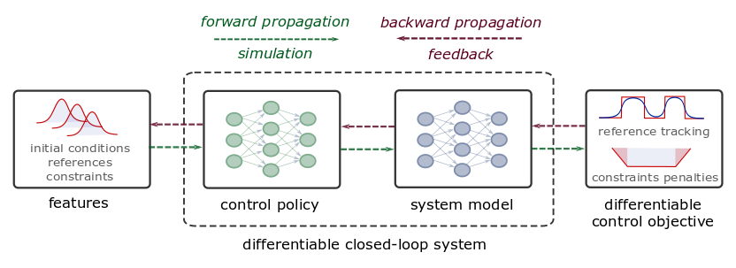
Differentiable Predictive Control
Constrained Model-based Policy Optimization for Parametric Optimal Control
Jan Drgona, Aaron Tuor, Draguna Vrabie, Learning Constrained Adaptive Differentiable Predictive Control Policies With Guarantees
https://arxiv.org/abs/2004.11184
Jan Drgona, et al., Differentiable Predictive Control: An MPC Alternative for Unknown Nonlinear Systems using Constrained Deep Learning https://arxiv.org/abs/2011.03699

Slide 10
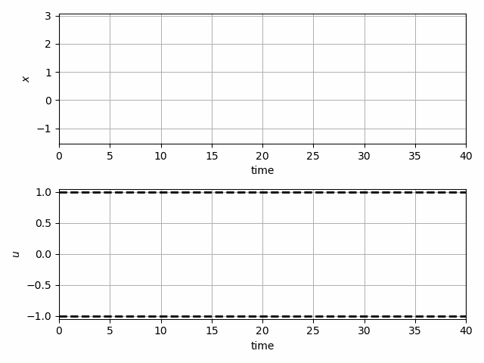
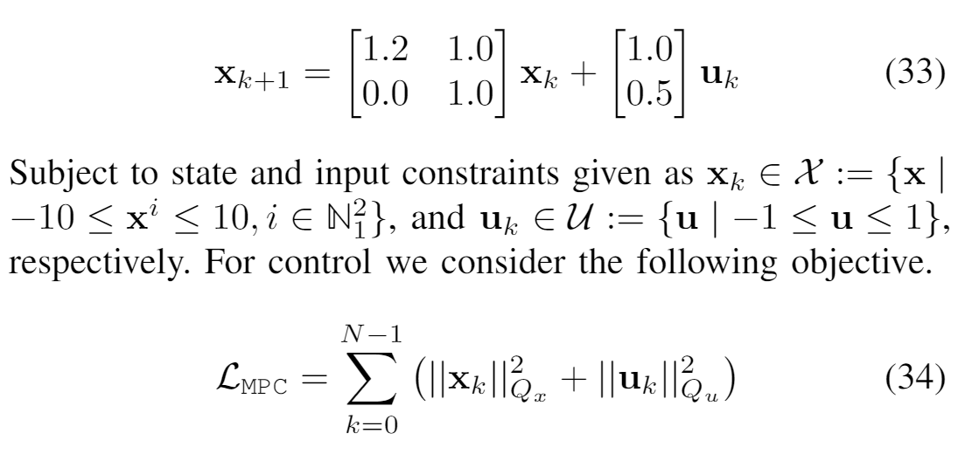
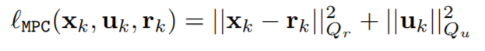
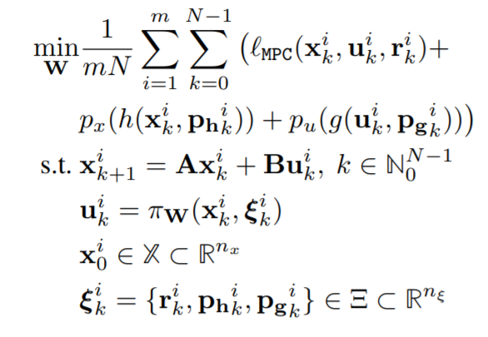
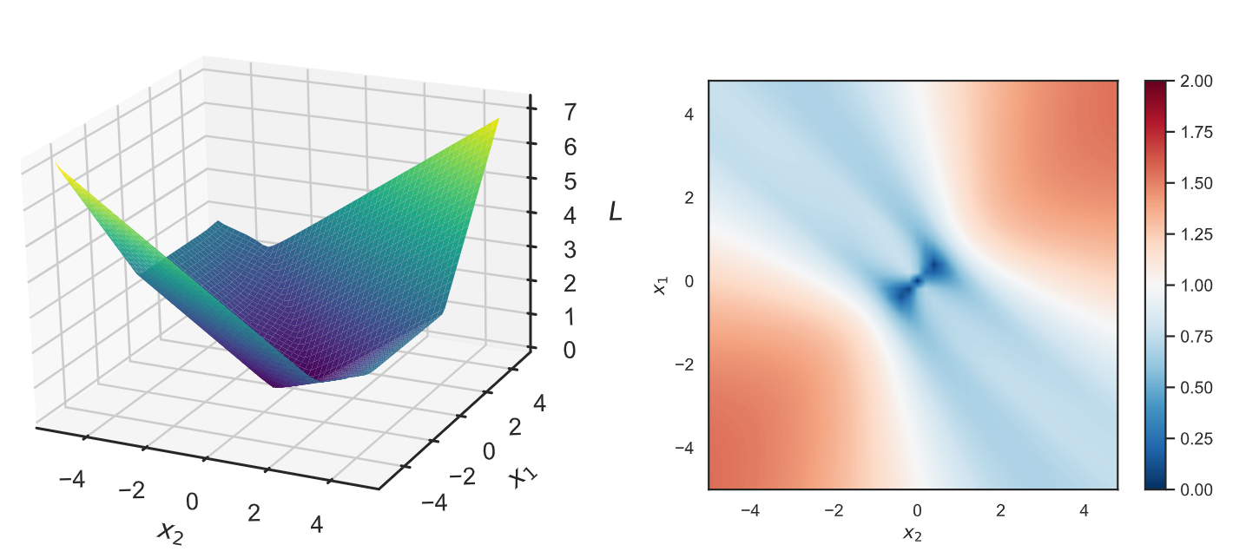
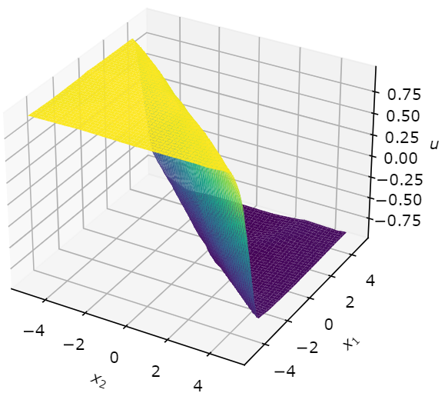
Learning to Stabilize Unstable System
Problem setup:
DPC formulation:
Jan Drgona, Aaron Tuor, Draguna Vrabie, Learning Constrained Adaptive Differentiable Predictive Control Policies With Guarantees, https://arxiv.org/abs/2004.11184

Slide 11
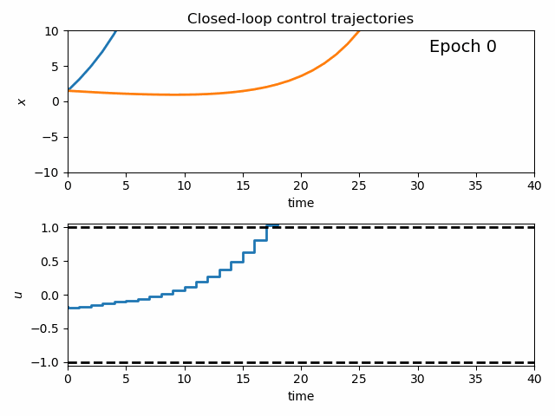
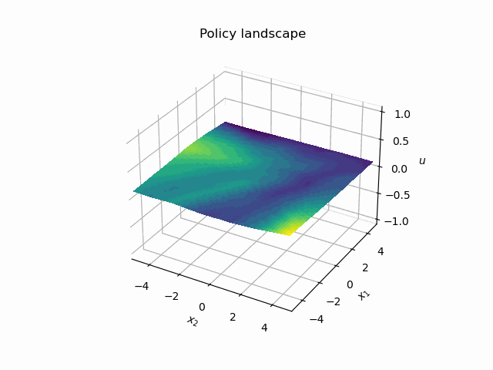
Dynamics of DPC Control Policy Learning
1341 learning parameters, 48.2 seconds offline training time on a CPU with 200 epochs.
Jan Drgona, Aaron Tuor, Draguna Vrabie, Learning Constrained Adaptive Differentiable Predictive Control Policies With Guarantees, https://arxiv.org/abs/2004.11184

Slide 12
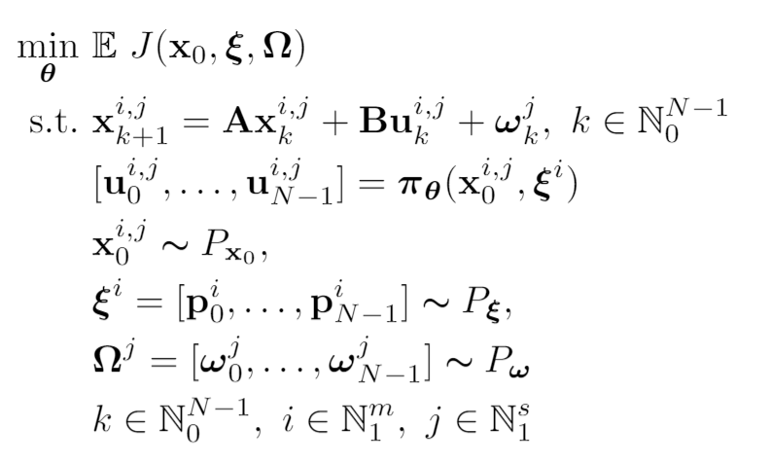
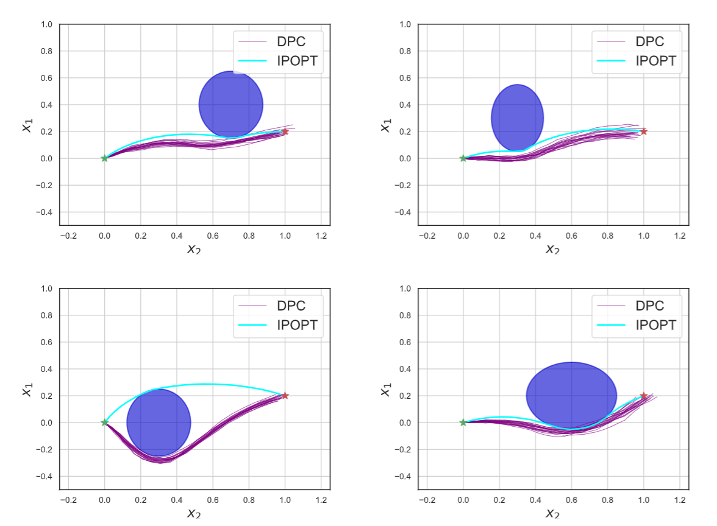
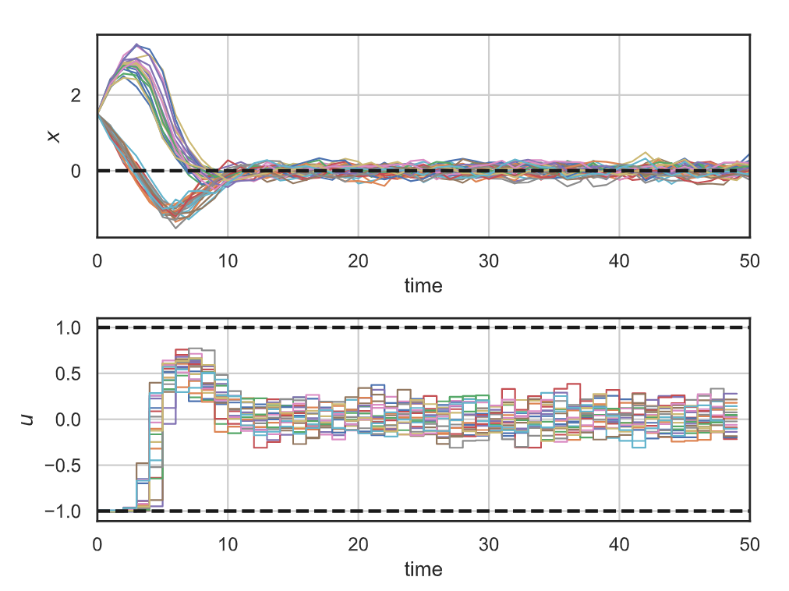
Stochastic Differentiable Predictive Control
Stochastic obstacle avoidance
Stochastic
formulation
Parameters
Uncertainties
Robustness
to state noise
Jan Drgona, Sayak Mukherjee, Aaron Tuor, Mahantesh Halappanavar, Draguna Vrabie, Learning Stochastic Parametric Differentiable Predictive Control Policies, arXiv:2203.01447, to appear at IFAC ROCOND 2022

Slide 13
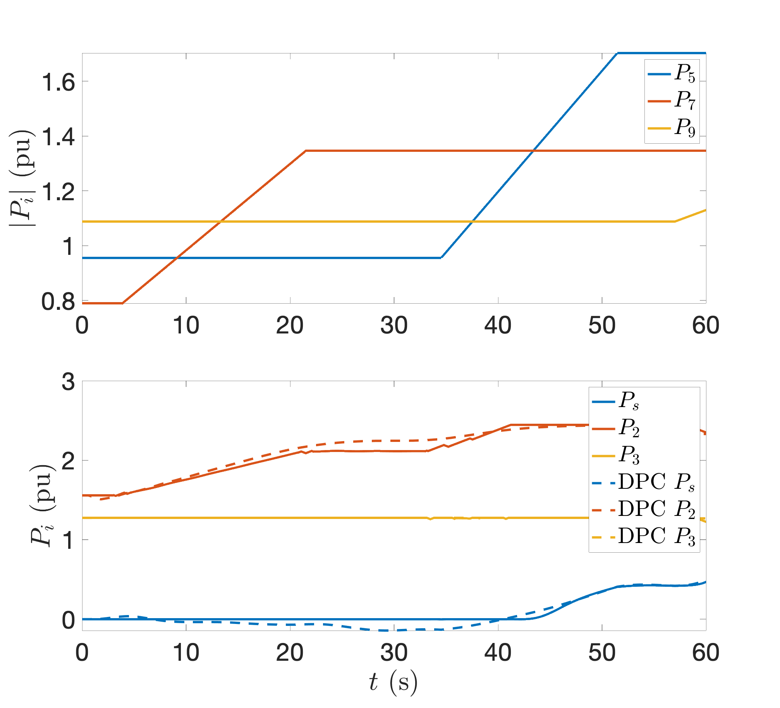
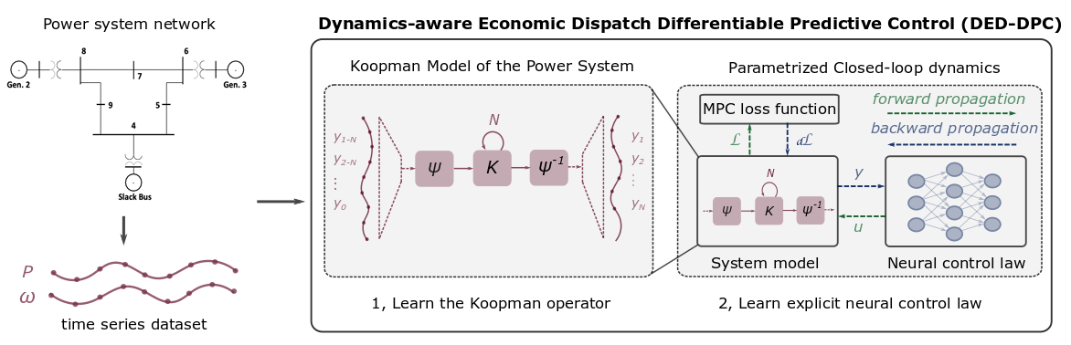
Dynamics-Aware Economic Redispatch via Differentiable Predictive Control
Problem: Current redispatch processes do not incorporate system dynamics concerns. Incorporating dynamics in redispatch is too complex and/or time-consuming
Architectures
Koopman dynamics model
CNN control policy
Solution: Machine-learning based dynamics-aware redispatch. Learn system dynamics for faster assessment.
Results
5 orders of magnitude speed-up
Minimal loss in solution quality
Ethan King, Ján Drgoňa, Aaron Tuor, Shrirang Abhyankar, Craig Bakker, Arnab Bhattacharya, Draguna Vrabie, Koopman-based Differentiable Predictive Control for the Dynamics-Aware Economic Dispatch Problem, The 2022 American Control Conference (ACC)

Slide 14
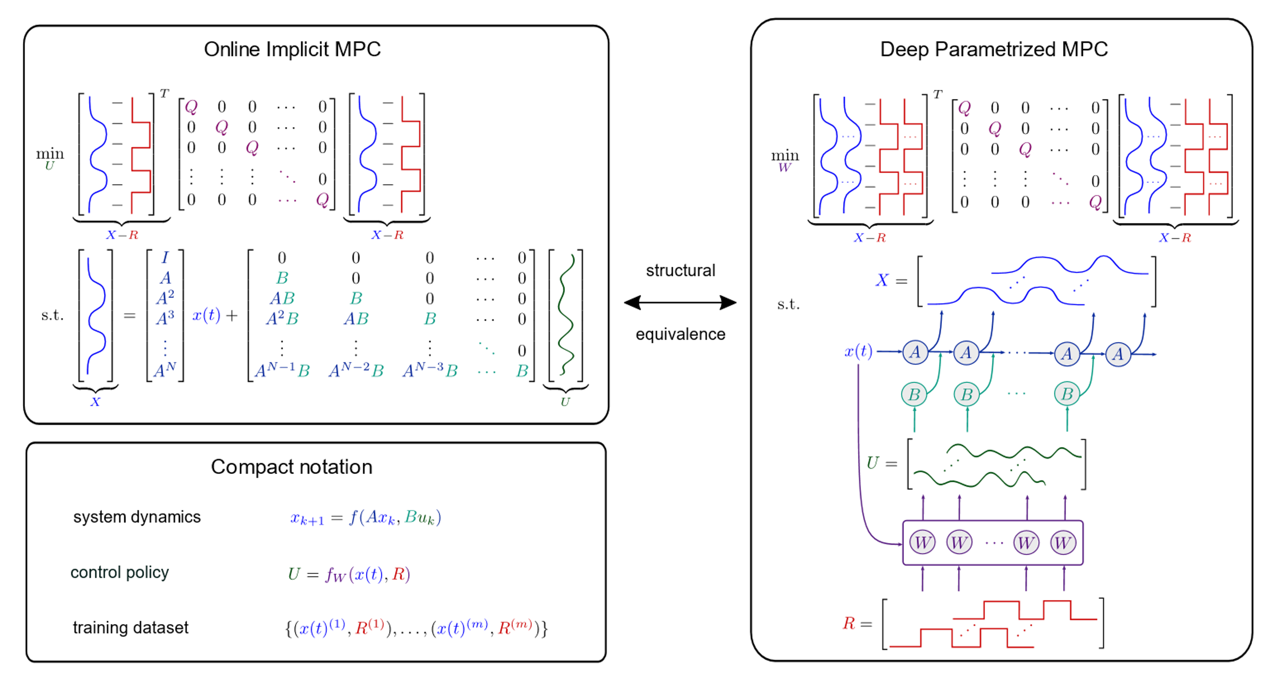
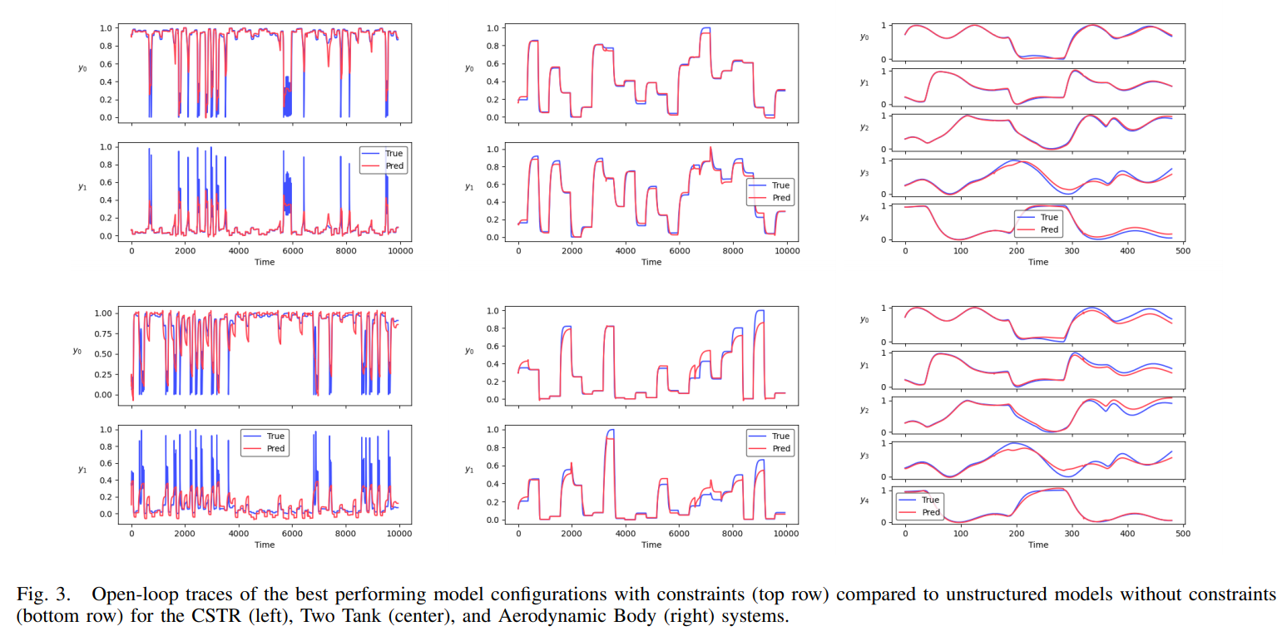
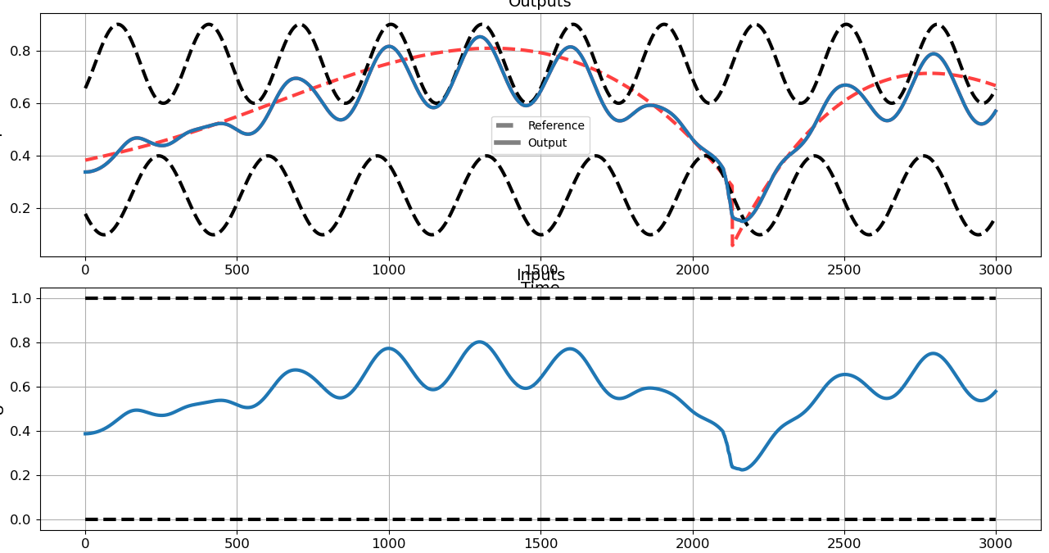
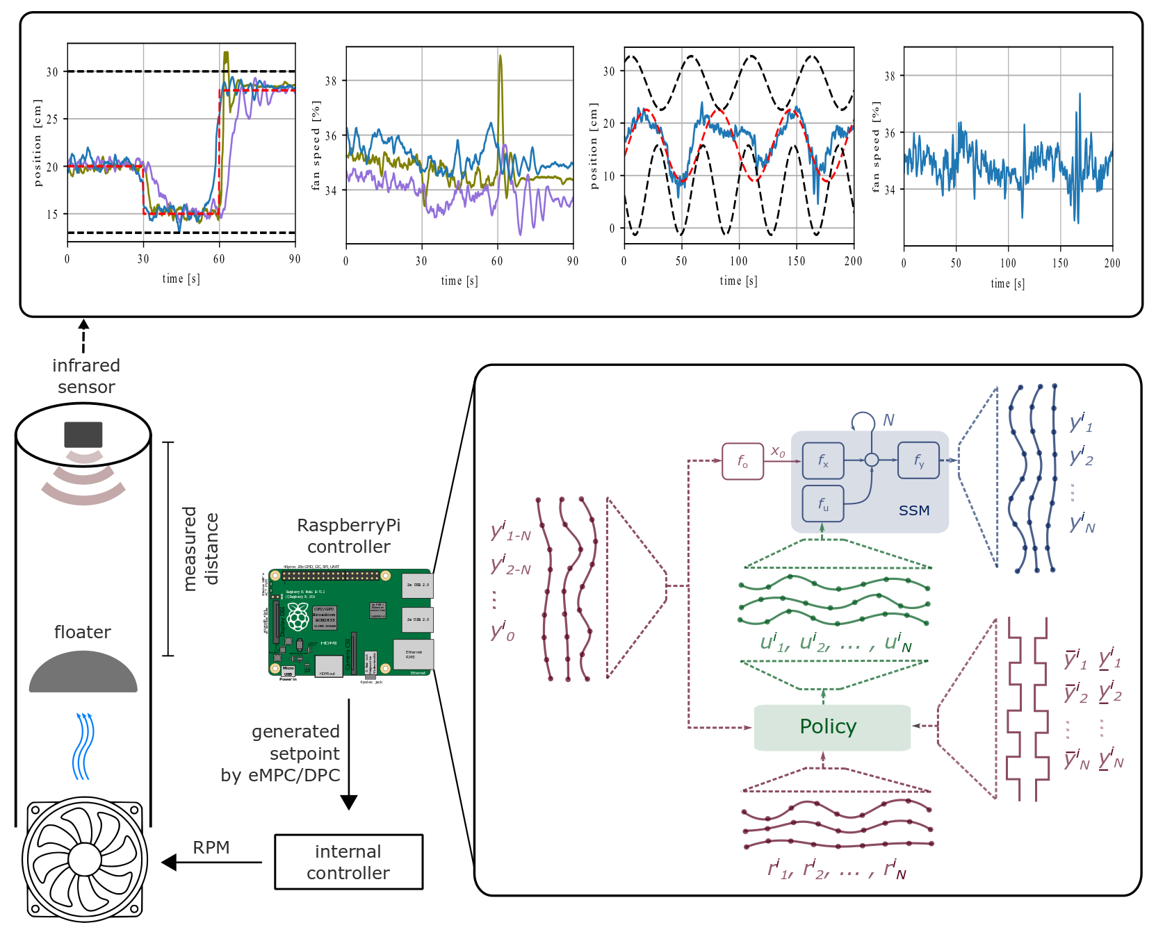
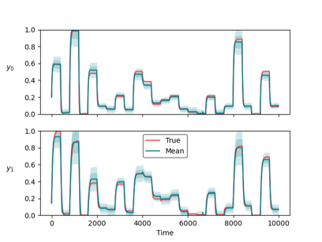
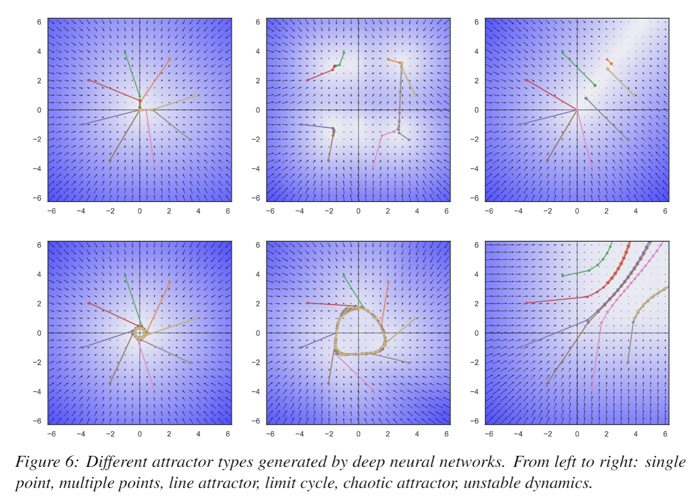
Conclusion
NeuroMANCER
Differentiable programming
Parametric programming
Constrained optimization
Dynamical modeling and control
Ongoing work
Constrained optimization solvers
Graph neural networks (GNNs)
Mixed-integer programs (MIP)
Uncertainty Quantification (UQ)
Long-Term Vision
Causal discovery, dynamical coupling, sensitivity, structure, and stability analysis, machine reasoning
Solving large-scale non-convex parametric constrained optimization problems
https://github.com/pnnl/neuromancer
https://github.com/pnnl/slim

Slide 15
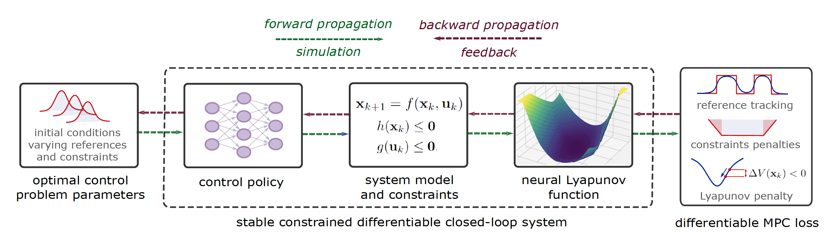
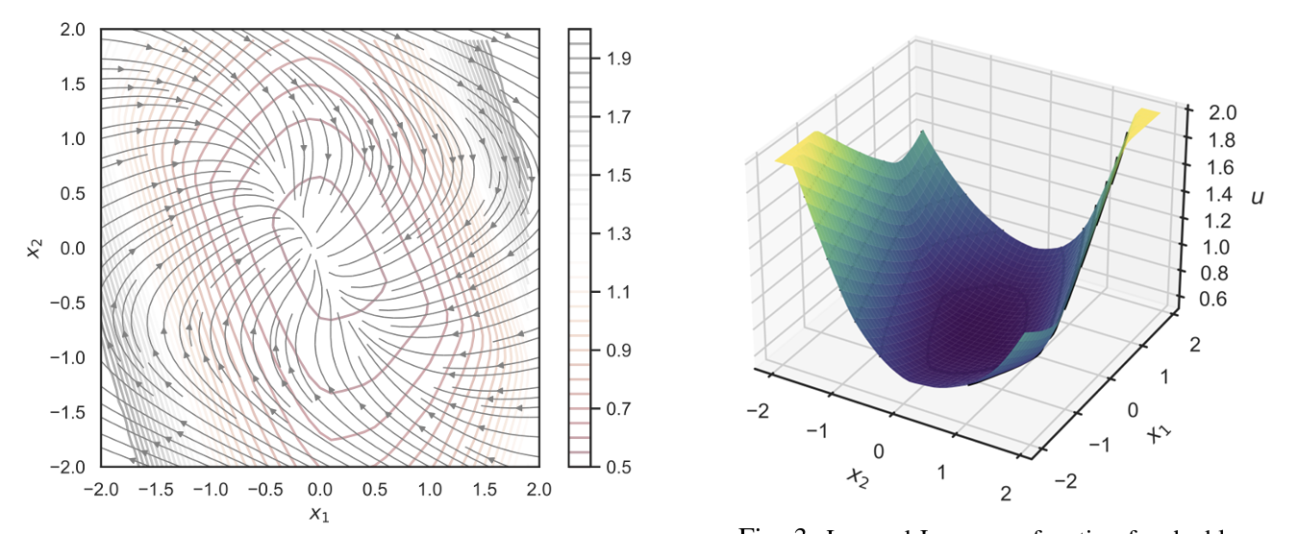
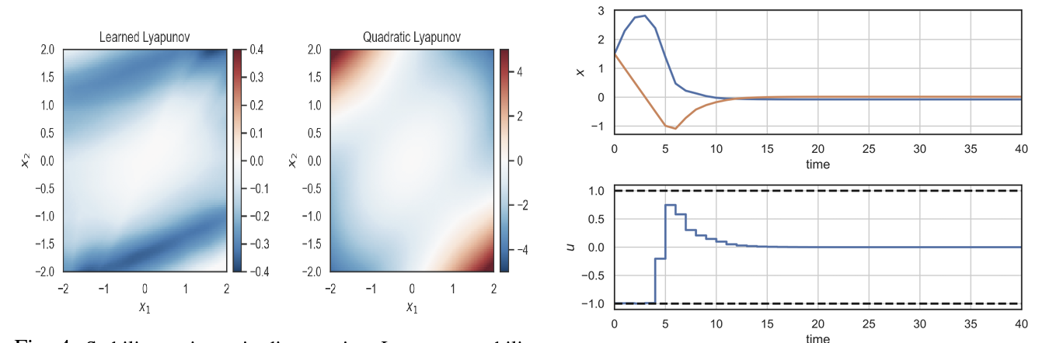
Learning Stable Policies via Neural Lyapunov Differentiable Predictive Control
Sayak Mukherjee, Ján Drgoňa, Aaron Tuor, Mahantesh Halappanavar, Draguna Vrabie, Neural Lyapunov Differentiable Predictive Control, arXiv:2205.10728, accepted to IEEE Conference on Decision and Control, 2022

Slide 16
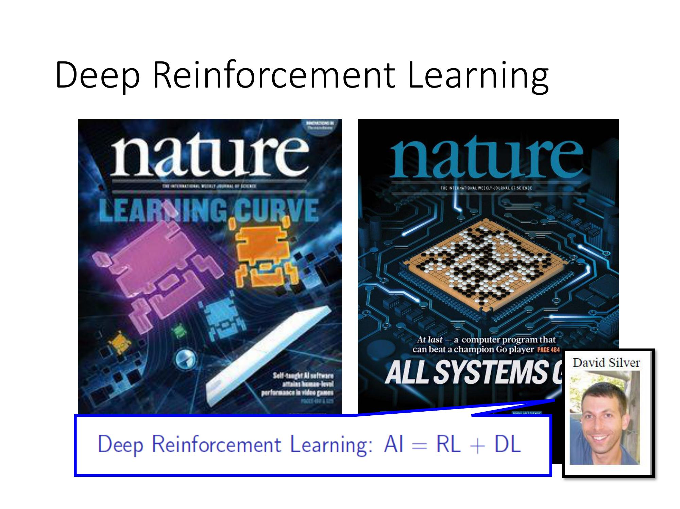
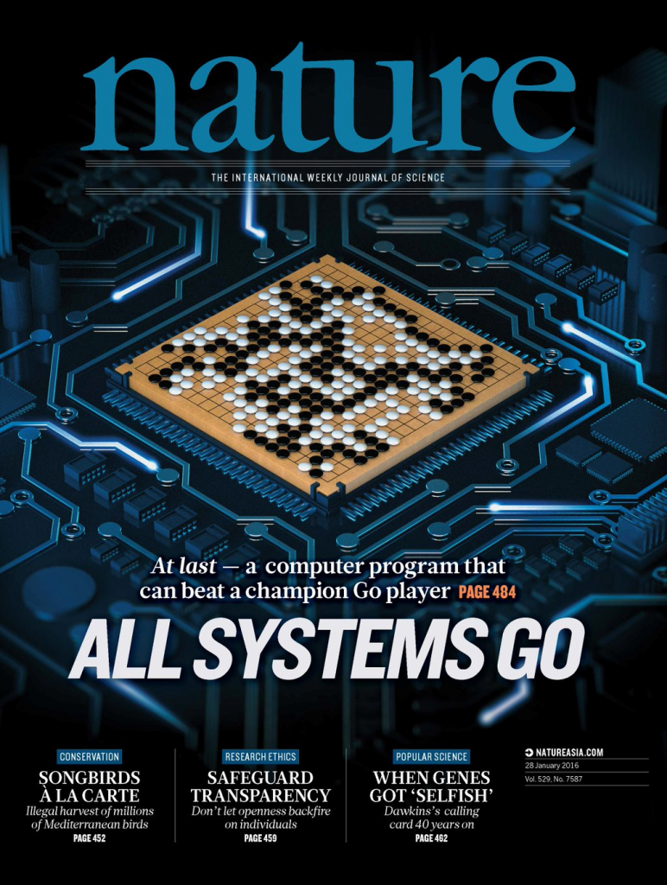
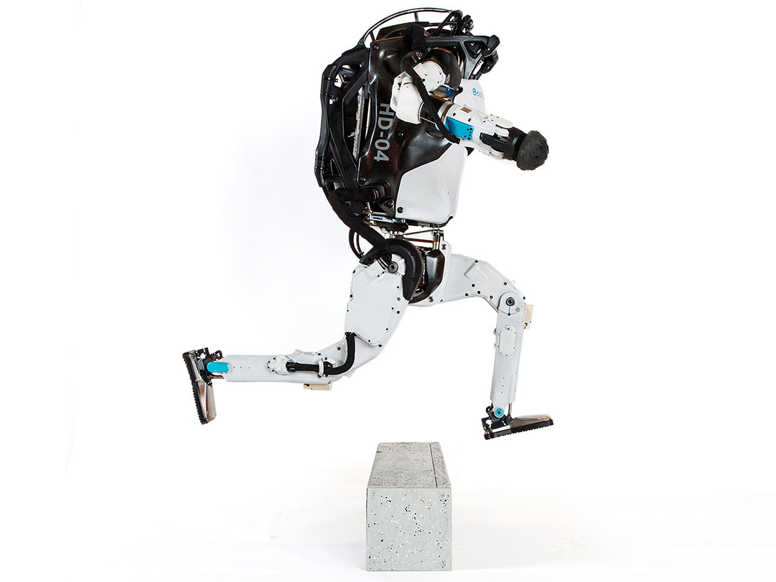
Model Predictive Control vs Deep Reinforcement Learning
MPC
RL
95% of the industrial control applications are PID loops & expert driven rule-based control (RBC).
The rest is model predictive control (MPC).
Everywhere where you have reliable digital environment model, mostly discrete action space, and you can use massive compute to solve the problem.
Drgona J., J. Arroyo, I.C. Figueroa, D. Blum, K. Arendt, D. Kim, and E.P. Olle, J. Oravec, M. Wetter, D. L. Vrabie, L. Helsen. 2020. "All You Need to Know About Model Predictive Control for Buildings." Annual Reviews in Control, September 29, 2020
G. Dulac-Arnold, D. J. Mankowitz, and T. Hester, “Challenges of real-world reinforcement learning,”, 2019.
http://arxiv.org/abs/1904.12901

